Slide 1
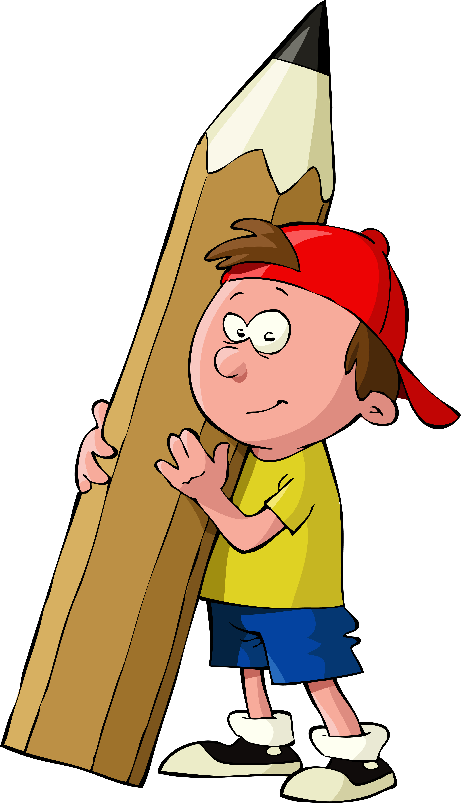
5th grade Podcasts
Unit 1: Playing with Words
Notes:
Please Note: The file contains stock imagery that The Walking Classroom has purchased the right to use. These images are not free to use. Thank you!

Slide 2

(3) Idioms
I’m free as
a bird!

Slide 3
Objectives (7) Idioms
Students will:
-Analyze common idioms of the English language and learn of their history.
-Interpret idiomatic expressions from other languages.

Slide 4
Synopsis (7) Idioms
Today’s Walking Classroom podcast focuses on idioms. Idioms are groups of words that, when said together, have an understood meaning that is different from what the words actually mean. For example, “to be on the moon” doesn’t actually mean that a person is on the moon, it is an idiom that people say when someone is very distracted. All languages have idioms, and sometimes it can be difficult for people who are learning a new language to understand the meanings behind them.

Slide 5
Vocab (7) Idioms
familiarity (noun): knowledge of, to be familiar with someone or something
I had no familiarity with the game of Cricket, so I was unable to tell which team was winning or by how much.
originated (verb): the time frame or place when something began
Although it is a modern-day American favorite, the fairy tale “Little Red Riding Hood” originated in Europe more than 400 years ago.

Slide 6
Recap (7) Idioms
An idiom is a group of words whose literal meaning is different than the actually meaning of the expression.
The origins of many idioms can be traced to an event or custom, but the origin of many idioms is unknown.
Most language have their own idioms is unknown.
Most languages have their own idioms, and an unfamiliarity with the language can lead to misunderstandings of intended meanings.

